Slide 1


Classification
Models
Employee Promotion
, Abdulmajeed Alnfaie
, Nouf Alshabani
, Ahmad Hakami

Slide 2
INTRODUCTION
There are many companies trying to determine which employees are eligible for a promotion by a certain evaluation, and with thousands of employees, this is delaying the transition to new positions. Hence, the company needs to help identify the qualified candidates at a particular checkpoint so that they can speed up the entire promotion cycle.
INSPIRATION
We try predict whether a potential promote at checkpoint in the test set will be promoted or not after the evaluation process.

Slide 3
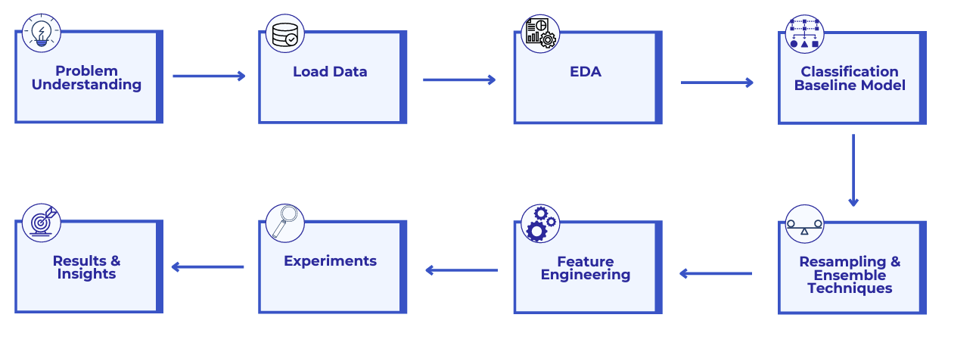



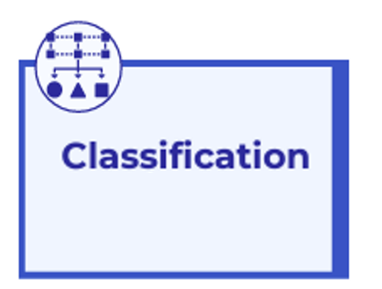

Methodology

Slide 4


Source
Dataset
HR Analytics: Employee Promotion Data
It was uploaded in Kaggle.com
Records
54808 Employee Records
Features
13 Features
id , department, education, gender, lenght_of_service,… etc.
Target
Predict the eligible candidates for promotion

Slide 5
Dataset
Type | Describtion | Name of Columns
int64 | Unique ID for employee | Employee_id
object | Department of employee | department
object | Region of employment (unordered) | region
object | Education Level | Education
object | Gender of Employee | Gender
object | Channel of recruitment for employee | recruitment_channel
int64 | no of other trainings completed in previous year on soft skills, technical skills etc. | no_of_trainings
int64 | Age of Employee | age
float64 | Employee Rating for the previous year | previous_year_rating
int64 | Length of service in years | length_of_service
int64 | if awards won during previous year then 1 else 0 | awards_won?
int64 | Average score in current training evaluations | avg_training_score
int64 | Recommended for promotion (Target) | is_promoted

Slide 6
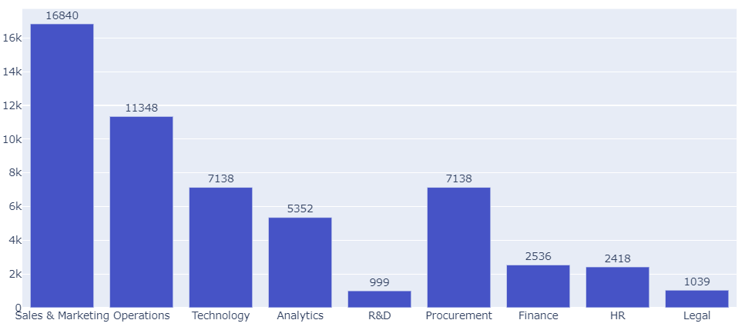
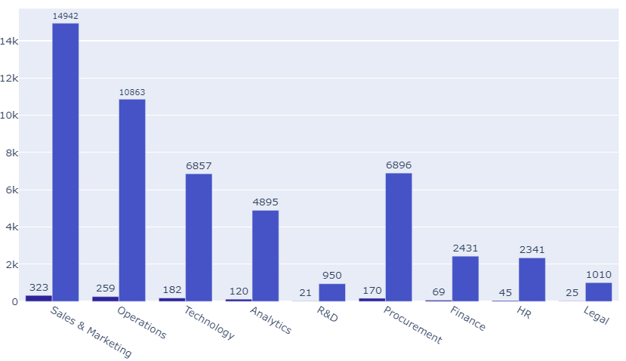

Exploratory Data Analysis
Distribution of Employees in Different Departments
The highest number of award by departement
The highest number of department on dataframe is about 16840 in Sales & marketing and the lowest number is about 999 in R&D
The highest number of award by departement on dataframe is about 323 in Sales & marketing and the lowest number is about 25 in Legal

Slide 7
Features
Engineering
Convert Categorical Columns to label Variables
Resulted in decreasing the models' scores.

Slide 8
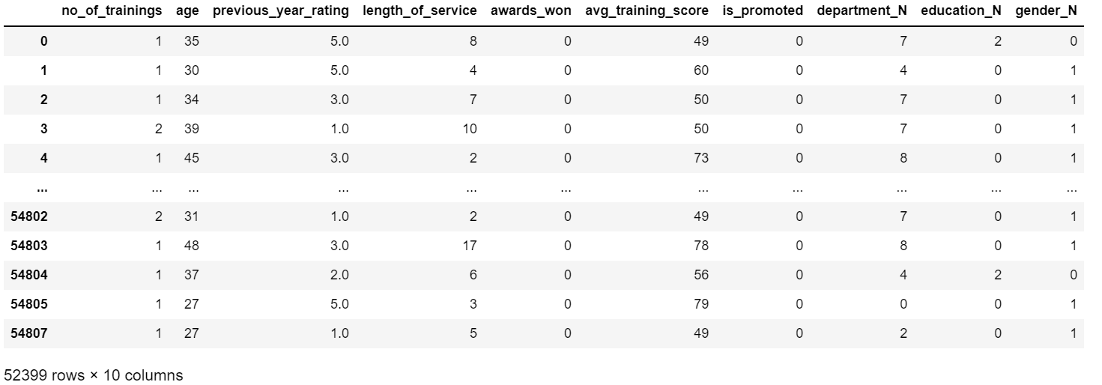
Dataset After preprocessing

Slide 9
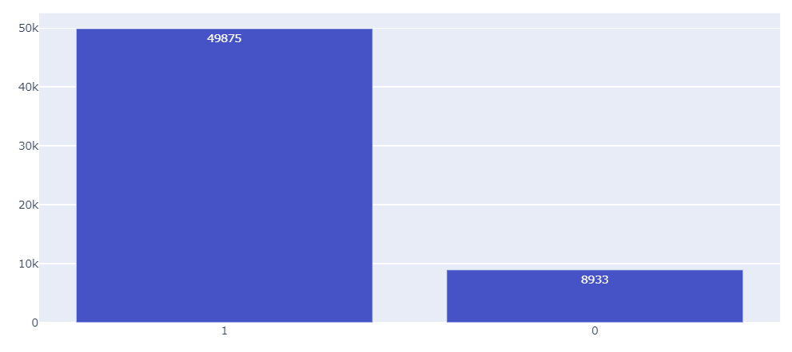
Data Imbalance
Promoted 0 v.s Promoted 1
Number Of Observation
54808
Number Of Promoted 1
49875
Number Of Promoted 0
4933
Event rate 8.2 %
1

Slide 10
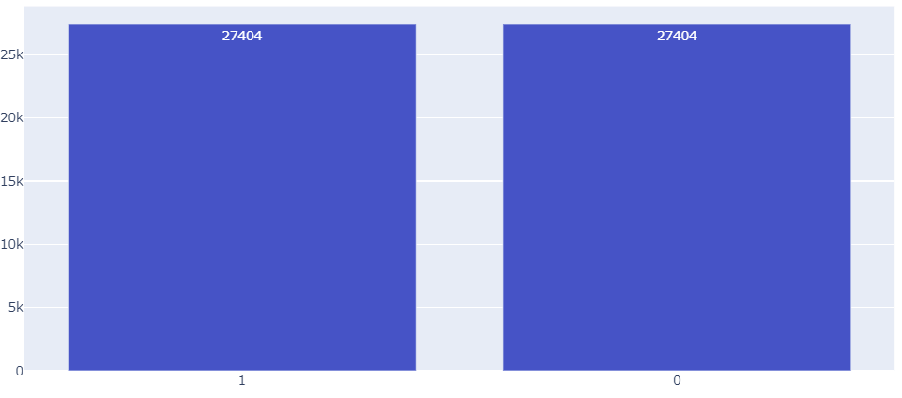

Data Imbalance
Promoted 0 v.s Promoted 1
Approache for Imbalanced Data
Resampling Technique:
Random Over-Sampling
1

Slide 11
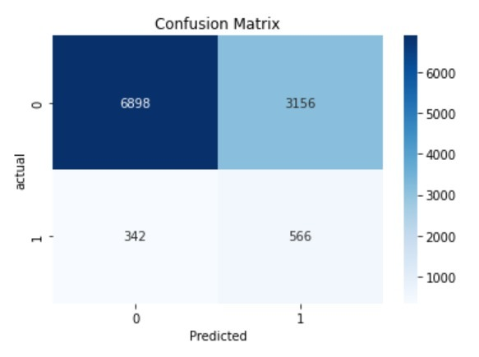

Logistic Regression()
Testing Scores
68.08 | = | Accuracy
15.20 | = | Precision
62.33 | = | Recall
24.44 | = | F-1
precision recall f1 support
0 0.95 0.69 0.80 1054
1 0.15 0.62 0.24 908
accuracy 0.68 10962
macro avg 0.55 0.65 0.52 10962
weighted avg 0.89 0.68 0.75 10962

Slide 12
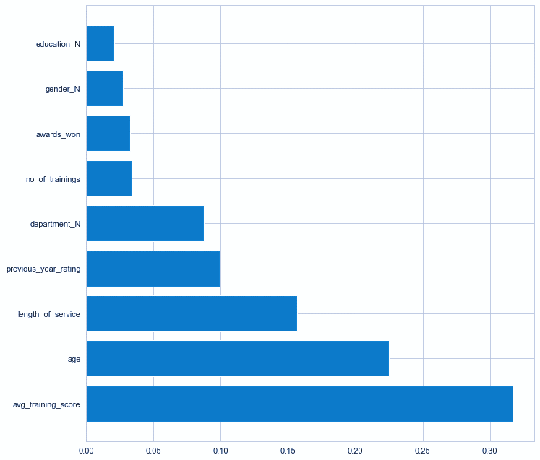
Feature importance
for random forest
low Feature importance
- Education_N
- Gender_N
- Awards_won

Slide 13
Experiments
F-1 | Recall | Precision | Accuracy | Classifier
18.29 | 46.72 | 11.37 | 65.31 | Validation | KNN
18.34 | 45.53 | 11.48 | 64.92 | Test | KNN
20.96 | 58.89 | 12.74 | 63 | Validation | Logistic Regression
21.51 | 58.10 | 13.20 | 63.31 | Test
21 | 60.39 | 12.75 | 62 | Validation | Random Forest
21.54 | 59.75 | 13 | 62 | Test
20.23 | 71.87 | 11.77 | 52.91 | Validation | XGBoost
20.38 | 68.90 | 11.96 | 53.48 | Test | XGBoost
20.18 | 51.77 | 12.53 | 65.96 | Validation | LGBM
21 | 52 | 13.23 | 66.33 | Test
17.14 | 9.52 | 85.56 | 92 | Validation | Stacking
18.53 | 32.74 | 13 | 75 | Test
Split Data
60% train, 20% Validation 20% test
Resampling Technique
Random Over-Sampling

Slide 14
Experiments
F-1 | Recall | Precision | Accuracy | Classifier
18.29 | 46.72 | 11.37 | 65.31 | Validation | KNN
18.34 | 45.53 | 11.48 | 64.92 | Test | KNN
20.96 | 58.89 | 12.74 | 63 | Validation | Logistic Regression
21.51 | 58.10 | 13.20 | 63.31 | Test
21 | 60.39 | 12.75 | 62 | Validation | Random Forest
21.54 | 59.75 | 13 | 62 | Test
20.23 | 71.87 | 11.77 | 52.91 | Validation | XGBoost
20.38 | 68.90 | 11.96 | 53.48 | Test | XGBoost
20.18 | 51.77 | 12.53 | 65.96 | Validation | LGBM
21 | 52 | 13.23 | 66.33 | Test
17.14 | 9.52 | 85.56 | 92 | Validation | Stacking
18.53 | 32.74 | 13 | 75 | Test
Split Data
60% train, 20% Validation 20% test
Resampling Technique
Random Over-Sampling

Slide 15
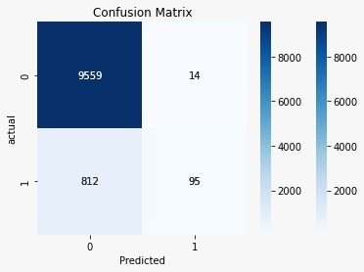

XGBoost (Imbalanced)
Testing Scores
92.12 | = | Accuracy
87.16 | = | Precision
10.5 | = | Recall
19 | = | F-1
precision recall f1 support
0 0.92 1.00 0.96 9573
1 0.87 0.10 0.19 907
accuracy 0.92 10480
macro avg 0.90 0.55 0.57 10480
weighted avg 0.92 0.92 0.89 10480

Slide 16
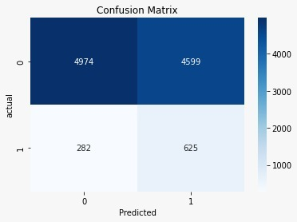
XGBoost (balanced)
Testing Scores
53.43 | = | Accuracy
12 | = | Precision
69 | = | Recall
20.4 | = | F-1
precision recall f1 support
0 0.95 0.52 0.67 9573
1 0.12 0.69 0.20 907
accuracy 0.53 10480
macro avg 0.53 060 0.44 10480
weighted avg 0.87 0.53 0.63 10480

Slide 17
Conclusion
1. Classifier Performance Metrics of interest
Accuracy, Recall, Precision, F-1
2. Random over-sampling for Handling Imbalance Data
3. XGBoost is the Best Classifier for this dataset
With Accuracy = 53.43 , precision = 12 , recall = 69 , F-1 = 20.4
Future work
1. Correcting errors, if any
2. Work on tuning the classifiers more, and try other classifiers

Slide 18






Tools
Jupyter
Notebook
Scikit-learn
Seaborn
Python Programming Language
Plotly
Pandas

Slide 19
Thank You
Dr. Patrick Saoud
For Everything!

Slide 20
Thank You!
Any Question?
Abdulmajeed
Nouf
Ahmad
Github @AbdulamjeedAlnefaie
Github @NoufAlshabani
Github @AhmadHakami

